Slide 1
Writing Better Unit Tests
Steven Slegel

Slide 2
Overview
This presentation outlines some ideas for writing better unit tests.
These ideas are based on an existing unit test framework called the xUnit Family of Unit Test Frameworks (JUnit, CppUnit…).
I have successfully implemented these ideas into my own UTF unit test environment while developing unit tests for the Experiment Manager Task on the ELC project … and I like it.
These ideas are a enhancement to the UTF we already use and does not break compatibility with unit tests that have already been written.

Slide 3
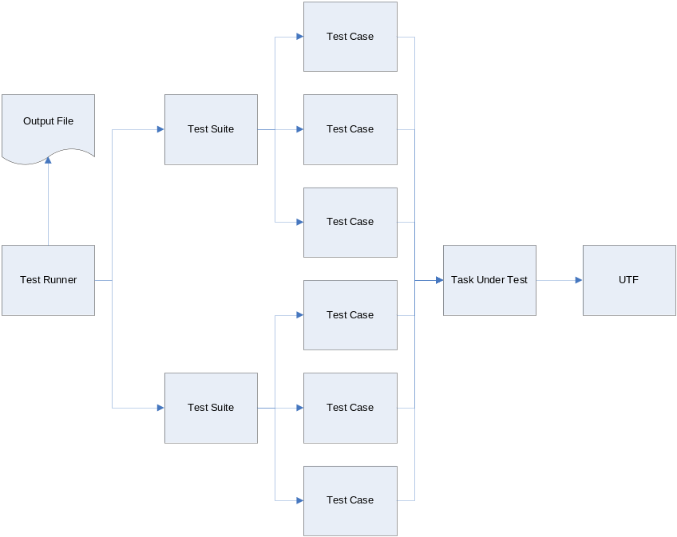
The Big Picture
Unit Tests should be organized into the following components:
  Test Runner
    Top level main function that executes all tests.
  Test Suite
    A collection of related test cases
  Test Case
    A function that verifies one condition

Slide 4
The Test Case
Each test case should only test 1 condition.
  Keeping the test cases simple makes them easier to understand and maintain.
Each test case should be independent of all other test cases.
  Everything is reinitialized for each test case so all tests run in a common environment.
Each test case should be self verifying.
  Pass/Fail status is determined automatically by the test case.

Slide 5
Test Case Implementation
Each test case follows a naming convention that includes the name of the function being tested followed by a test case number.
Each test case performs the following steps:
  Calls a setup function to initialize the test environment.
    The setup function includes a text string that describes what is being tested.
  Initializes all inputs for the test case.
    Function parameters, global variables, command packets . . .
    Input packets should be created inside the test case and added to UTF input queues instead of reading input packets from files.
    Test data could also be read from input data files.
  Executes the test case by calling the function to be tested.
  Verifies all outputs from the test case.
    Return values, global variables, telemetry packets, event messages . . .
  Calls a teardown function to perform any necessary cleanup.

Slide 6
Example Test Cases
Each test case follows a naming convention that includes the name of the function being tested along with a test case number
/* EM_GetExPASubsetID - Experiment 0 */
void EM_GetExPASubsetID_TestCase01(void)
{
EM_API_Setup("Test: EM_GetExPASubsetID_TestCase01 - Experiment 0");
AssertTrue(EM_GetExPASubsetID(0) == 111, "Subset ID Experiment 0 == 111");
EM_API_TearDown();
}
/* EM_GetExPASubsetID - Experiment 1 */
void EM_GetExPASubsetID_TestCase02(void)
{
EM_API_Setup("Test: EM_GetExPASubsetID_TestCase02 - Experiment 1");
AssertTrue(EM_GetExPASubsetID(1) == 112, "Subset ID Experiment 1 == 112");
EM_API_TearDown();
}
/* EM_GetExPASubsetID - Invalid Experiment Number */
void EM_GetExPASubsetID_TestCase03(void)
{
EM_API_Setup("Test: EM_GetExPASubsetID_TestCase03 - Invalid Experiment Number");
AssertTrue(EM_GetExPASubsetID(2) == 0xFFFF, "Invalid Experiment Subset ID == 0xFFFF");
EM_API_TearDown();
}
Initialize test environment
Execute the test and verify results
Cleanup test environment

Slide 7
More Example Test Cases
/* Service Request ID Not In The Table */
void EM_ReportServiceRequest_TestCase01(void)
{
EM_ExPATelemetry_t ExPATelemetry;
EM_HkTlmPkt_t HkTlmPkt;
EM_SrvReq_Setup("Test: EM_ReportServiceRequest_TestCase01 - Verify that an generic event is output when the Service Request does not match an entry in the lookup table");
/* Initialize Inputs */
memset(&ExPATelemetry, 0, sizeof(ExPATelemetry));
memset(&HkTlmPkt, 0xFF, sizeof(EM_HkTlmPkt_t));
ExPATelemetry.ServiceReqID = 5;
ExPATelemetry.ServiceReqData = 5;
/* Execute Test */
EM_ReportServiceRequest(&ExPATelemetry, 1);
/* Verify Outputs */
EM_GetServiceRequestStatus(&HkTlmPkt);
AssertTrue(HkTlmPkt.Fast.ExPAServiceReqSentCount[1] == 1, "HkTlmPkt.Fast.ExPAServiceReqSentCount[1] == 1");
AssertTrue(HkTlmPkt.Fast.ExPALastServiceRequest[1].ServiceReqID == 5, "HkTlmPkt.Fast.ExPALastServiceRequest[1].ServiceReqID == 5");
AssertTrue(HkTlmPkt.Fast.ExPALastServiceRequest[1].ServiceReqData == 5, "HkTlmPkt.Fast.ExPALastServiceRequest[1].ServiceReqData == 5");
AssertEventSent("MEM004 Service Request From Experiment 1: Service Request ID: 5, Service Request Data: 5", "Start Service Request Rejected Event Sent");
EM_SrvReq_TearDown();
}

Slide 8
Verifying Test Results
Test results are verified by using asserts.
  Each assert evaluates an expression to either TRUE (the test passed) or FALSE (the test failed).
  Each assert includes a text string that describes the condition being evaluated.
The text description as well as the pass/fail status of each assert is written to a output file.
Packets and events output from the test are stored in output queues so they can be verified after the test is complete.

Slide 9
Example Asserts
Default asserts.
  AssertTrue – Verifies a boolean expression
  AssertStrnCmp – Verifies 2 strings are the same
  AssertMemCmp – Verifies 2 memory areas are the same
  AssertMemChkValue – Verifies memory contains a specified value
  AssertMemChkCount – Verifies memory contains a byte count pattern
  AssertFloatChk – Verifies floating point numbers
  AssertPacketSent – Verifies a specified packet was output
  AssertNoPacketSent – Verifies no packets were output
  AssertEventSent – Verifies a specified event was output
  AssertNoEventSent – Verifies no event was output
  AssertFailed – Explicitly fails a test (can be used for unimplemented test cases)
Custom asserts can be added as needed for cases not covered by the default asserts.

Slide 10
The Test Suite
A test suite is a collection of related test cases.
  Groups test cases in any way that makes sense.
    By File
    By Function
    Whatever . . .
Performs initialization required by all test cases contained in the test suite.

Slide 11
Test Suite Implementation
All Test Suites Contain the following:
  Test Suite Setup Function
    Calls the test runner setup function to perform initialization common to all test cases in all test suites.
    Performs initialization specifically required by the test cases contained in the test suite.
    Is called from every test case in the test suite prior to executing the test.
  Test Suite Teardown Function
    Calls the test runner teardown function to perform cleanup common to all test cases in all test suites.
    Performs cleanup specifically required by the test cases contained in the test suite.
    Is called from every test case in the test suite after executing the test.
  Test Suite Run Test Function
    Executes all test cases included in the test suite.
    Is called from the test runner to execute the test suite.
  Test Cases

Slide 12
Example Test Suite
void EM_ExPATlm_Setup(uint8 *Description)
{
TestRunnerSetup(Description);
UTF_add_input_queue(EM_EXPA1_HS_PID);
UTF_add_input_queue(EM_EXPA2_HS_PID);
}
void EM_ExPATlm_TearDown(void)
{
UTF_reset_input_queues();
UTF_reset_input_files();
TestRunnerTearDown();
}
void EM_ExPATlm_RunTests(void)
{
EM_InitExPATelemetry_TestCase01(); /* Power on Init */
EM_InitExPATelemetry_TestCase02(); /* Cold Init */
EM_InitExPATelemetry_TestCase03(); /* Warm Init */
EM_ResetExPATelemetryCounters_TestCase01(); /* Reset Counters */
EM_ProcessExPATelemetry_TestCase01(); /* EM_ProcessExPATelemetry - No Packets Available */
EM_ProcessExPATelemetry_TestCase02(); /* EM_ProcessExPATelemetry - 1 Packet Available ExPA 0 */
EM_ProcessExPATelemetry_TestCase03(); /* EM_ProcessExPATelemetry - 2 Packets Available ExPA 0 */
EM_ProcessExPATelemetry_TestCase04(); /* EM_ProcessExPATelemetry - 1 Packet Available ExPA 1 */
}
EM_InitExPATelemetry_TestCase01()
{
. . .
}
. . .
Test Setup function initializes the test environment
Test Teardown function cleans up after the test
Run Test Function executes all test cases included in the test suite.

Slide 13
The Test Runner
Executes all test cases.
Performs initialization required by all test cases.
Keeps track of the pass/fail status of all test cases.
Outputs the results of all test cases to an output file.
Prints a pass/fail test summary at the end of the unit test.

Slide 14
Test Runner Implementation
A Test Runner contains the following:
  Main Function
    Calls the run test functions for each test suite.
    Outputs a test results summary to the screen and the output file.
    Returns an error if any of the unit tests fail.
  Test Runner Setup Function
    Performs initialization required by all test cases.
    Prints a text description of each test case to the output file.
    For this example I call all task initialization functions passing them a OS_POWER_ON reset type to completely initialize the task.
    Is called from all test suite setup functions.
  Test Runner Teardown Function
    Performs cleanup required by all test cases.
    Is called from all test suite teardown functions.

Slide 15
Example Test Runner
int main(void)
{
UTF_set_output_filename("em_test_runner.out");
EM_API_RunTests();
EM_Main_RunTests();
EM_SrvReq_RunTests();
EM_ReqResp_RunTests();
EM_ExPATlm_RunTests();
EM_LRT_RunTests();
UTF_put_text("Tests Executed: %i\n", TestCount);
UTF_put_text("Pass Count: %i\n", PassCount);
UTF_put_text("Fail Count: %i\n", FailCount);
printf("Tests Executed: %i\n", TestCount);
printf("Pass Count: %i\n", PassCount);
printf("Fail Count: %i\n", FailCount);
return(FailCount > 0);
}
Unit Test main function
Execute all test suites
Print test results summary
Return a error if any of the test cases fail

Slide 16
Example Test Runner
Prints the test description to the output file
void TestRunnerSetup(uint8 *Description)
{
UTF_put_text("%s\n", Description);
memcpy(&EM_ConfigurationTable, &EM_ConfigurationTableEeprom, sizeof(EM_ConfigurationTable_t));
memcpy(&EM_LRTTable, &EM_LRTTableEeprom, sizeof(EM_LRTTable_t));
OS_TaskRegister();
EM_InitMain(OS_POWER_ON);
EM_InitServiceRequest(OS_POWER_ON);
EM_InitRequestResponse(OS_POWER_ON);
EM_InitExPATelemetry(OS_POWER_ON);
EM_InitLRT(OS_POWER_ON);
EventQueue = QueueCreate();
PacketQueue = QueueCreate();
UTF_set_default_packet_handler((utf_packet_handler)EM_SrvReqPacketHandler);
UTF_set_event_handler(EM_SrvReqEventHandler);
TestCount++;
}
void TestRunnerTearDown(void)
{
UTF_put_text("\n");
QueueDestroy(EventQueue);
QueueDestroy(PacketQueue);
}
Initialize SM tables
Call task initialization functions
Create queues to store the output packets and events
Count the number of tests executed
Destroy queues to store the output packets and events

Slide 17
The Output File
A Output File is created to document the unit test run.
  For each test case the name of the test case and a short description of the test is written to the output file.
  Pass/Fail Status of each assert along with a text description of what was verified is written to the output file.
  A Test Summary is printed at the end of the test and is also output to the console.
    Total number of test cases executed.
    Number of asserts that passed.
    Number of asserts that failed.

Slide 18
Example Output File
Test: EM_ExecGroundCommand_TestCase05 - Send Request Response Command - Experiment 0
< CMD: APID:000d SEQ:0 LEN:18 FC:4 PKT:180d c000 000b 0400 0001 0002 0003 0004 0000
> CMD: APID:0021 SEQ:0 LEN:586 FC:4 PKT:1821 c000 0243 0400 0007 0800 0000 0013 0000 0000 0004 0000 006f
> TLM: APID:000d SEQ:1 LEN:84 PKT:000d c001 004d 0000 0001 0000 0000 0000 0000 0000 0009 0001 0000 0000
PASS: CommandCounter == 1
PASS: Request Response Canned Command Packet Sent
Test: EM_ExecGroundCommand_TestCase07 - Send Request Response Command - Invalid Experiment
< CMD: APID:000d SEQ:0 LEN:18 FC:4 PKT:180d c000 000b 0400 0001 0002 0003 0004 0002
EVENT: MEM103 Invalid Experiment Number In Send Request Response Command: 2
> TLM: APID:000d SEQ:1 LEN:84 PKT:000d c001 004d 0000 0100 0000 0000 0000 0000 0000 0009 0001 0000 0000
PASS: CommandErrorCounter == 1
PASS: Command Error Event Message Sent
Test: EM_StartLRT_TestCase01 - Verify the Start LRT Command
> CMD: APID:0035 SEQ:0 LEN:8 FC:0 PKT:1835 c000 0001 0000
> CMD: APID:0026 SEQ:0 LEN:12 FC:0 PKT:1826 c000 0005 0000 0003 0009
PASS: LRT Output is Enabled
PASS: LRT Cleanup Command packet was sent to RT
PASS: Service Request packet was sent to Telemetry Output
PASS: ServiceReqID == EM_SVC_REQ_LRT_START
PASS: ServiceReqData == 9
. . .
Tests Executed: 213
Pass Count: 1238
Fail Count: 0
Test case name and description
Test case pass/fail status
Test Summary

Slide 19
Verifying Test Coverage
Test coverage should be verified by using an automated coverage analysis tool.
  GCOV is a coverage analysis tool available for the gnu compiler.
  To enable GCOV add the following switches to the compiler and linker options:
    COPT = -fprofile-arcs -ftest-coverage -pg –p
    LOPT = -pg -p -fprofile-arcs -ftest-coverage -lgcov
  Once the executable is built with GCOV enabled then run the test to collect statistics.
    To view the GCOV results for each source file type “gcov” followed by the name of a source file.
    This command produces a *.gcov file that marks each source line with the number of times that line of code has been executed or ##### for lines of code that have not been executed.

Slide 20
A Few More Tips
Unit tests should be developed at the same time the code is developed, not after the fact.
Design code with unit testing in mind to make the code easier to unit test.
  Promotes more modular design and cleaner code.

Slide 21
What Needs To Be Done
A few things need to be done before this will work with existing versions of UTF.
  Add reset functions to UTF to initialize it to a default state.
    This is currently only done once at startup and it needs to be done before each test case.
  Integrate some of the code directly into UTF.
    Integrate the output packet and event queues directly into UTF so each developer does not have to do it.
    Add the default asserts to UTF.
  Develop templates for a test runner, test suites, and test cases.
  Documentation Updates.

Slide 22
Summary
Keeping test cases small and simple makes them easier to understand and easier to maintain.
Self verifying unit tests.
  Documents the outputs being verified.
  Anyone can run the unit test and verify if the tests passed or failed
    No need to manually diff new output files (which almost always changes when the unit test changes) with previously accepted as correct output files.
  Running unit tests could be added to the build release process where all unit tests could be executed from a makefile.
Running the unit test is simple, no need for readme files that provide instructions on how to build and run the tests.
  A test summary is printed to the console so the results of the test are known immediately.
Using tools to automate coverage analysis helps verify that all lines of code have been executed.
  Complete coverage is a requirement in the branch unit test standard.
This can be implemented as a enhancement to the UTF that we already use without breaking compatibility with unit tests that have already been written.

